Slide 1
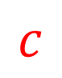
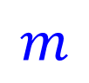
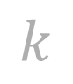
Spring
$$k$$
Mass
Damper
Motion
$$m$$
$$c$$

Slide 2
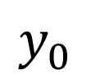
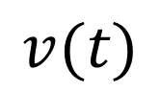
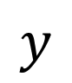

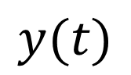
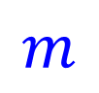
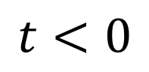
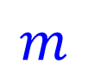
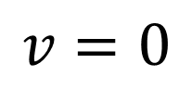
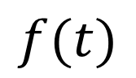
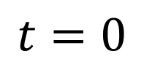
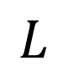
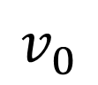
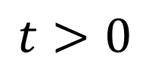
$$t<0$$
$$t=0$$
$$t>0$$
$$L$$
$$y_{0}$$
$$y$$
$$m$$
$$m$$
$$y(t)$$
$$v=0$$
$$m$$
$$v_{0}$$
$$v(t)$$
$$f(t)$$

Slide 3
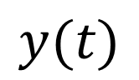
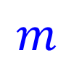
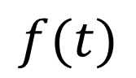
$$y(t)$$
$$m$$
$$f(t)$$

Slide 4
$$y(t)$$
$$m$$

Slide 5
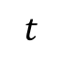
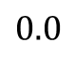
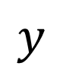
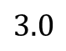
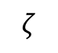
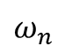
$$y$$
$$ω_{n}$$
$$3.0$$
$$t$$
$$ζ$$
$$0.0$$

Slide 6
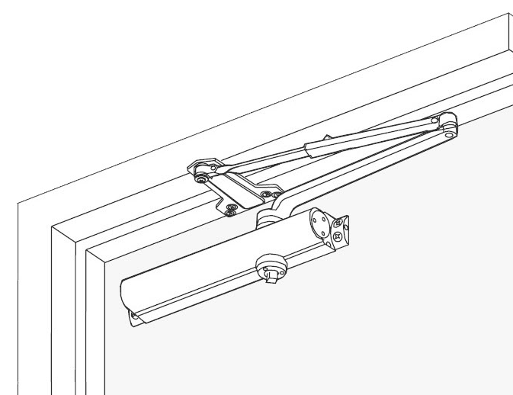
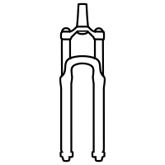
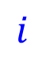
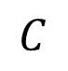
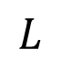
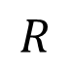
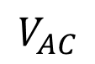
Motion
Motion
TMD
Air Valve
$$i$$
Wind
$$L$$
$$C$$
Motion
$$R$$
Motion
$$V_{AC}$$
Door Closer
Bike Suspension
Building
RLC Circuit

Slide 7
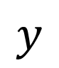
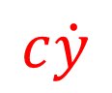
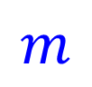

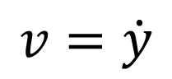
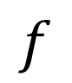
$$y$$
$$ky$$
$$c\dot{y}$$
$$v=\dot{y}$$
$$m$$
$$f$$

Slide 8
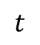
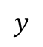
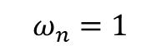
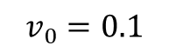
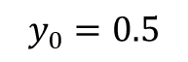
$$y$$
1
0
-1
$$t$$
0
3
$$y_{0}=0.5$$
$$v_{0}=0.1$$
$$ω_{n}=1$$

Slide 9
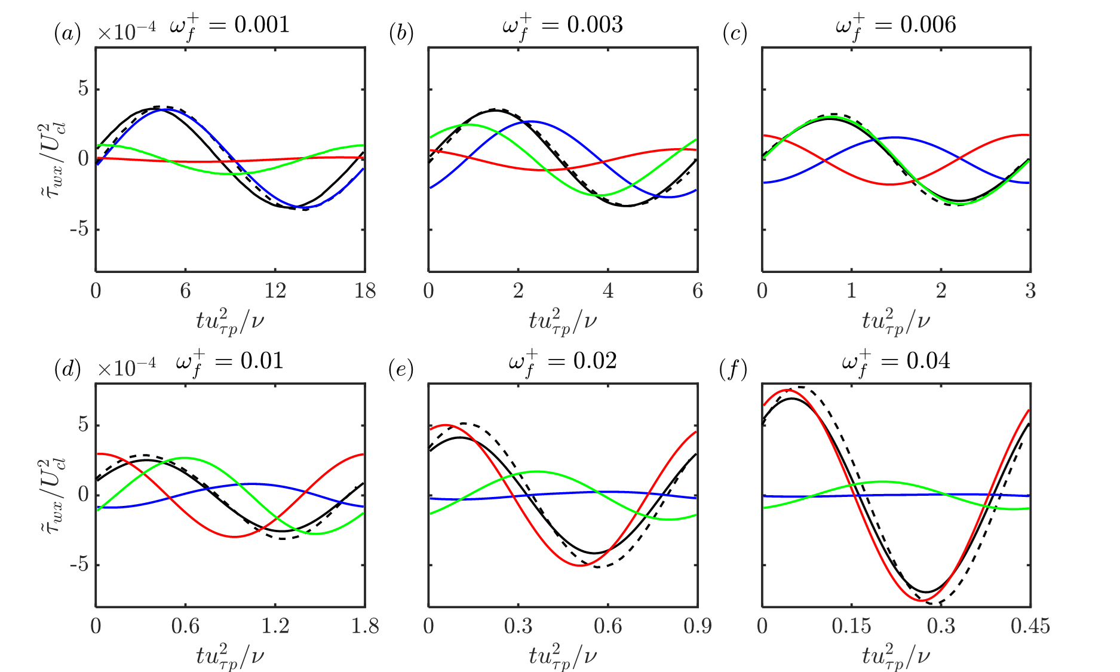
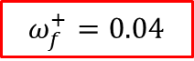
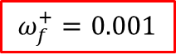
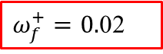
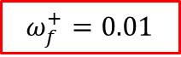
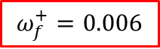
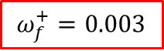
Pulsatile channel flow
$$ω_{f}^{+}=0.001$$
$$ω_{f}^{+}=0.003$$
$$ω_{f}^{+}=0.006$$
LaRTE
Intermediate frequency
Wall stress
lamNEQ
Quasi-steady
turbNEQ
DNS
MTSWM
LaRTE
$$ω_{f}^{+}=0.01$$
$ω_{f}^{+}=0.$02
$$ω_{f}^{+}=0.04$$
lamNEQ
turbNEQ
Wall stress
High frequency

Slide 10
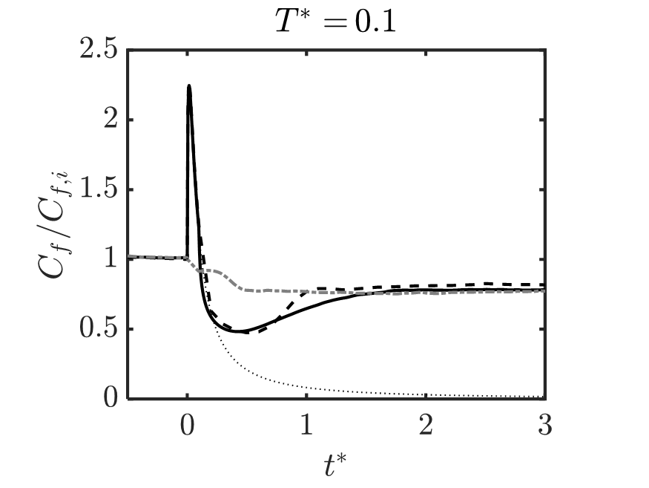

Linearly accelerating channel flow
Laminar stage
Transition stage
DNS
MTSWM
Final turbulent state
LaRTE
lamNEQ
turbNEQ
Laminar solution

Slide 11
Separated flow simulation results
DNS
MTSWM
EQWM

Slide 12


